Slide 1
Project 2 Discussion
It’s always a good idea to be ahead of the pack :)

Slide 2
Nachos Architecture
Nachos
Kernel
Kernel
User Level Code (COFF)
Kernel
Kernel
MIPS Simulator
Kernel
Java Virtual Machine
Kthread, Alarm, Uthread, UserKernel, UserProcess, etc. operate in the Kernel Model

Slide 3
User Level Process
Welcome to user level process
Until now we were writing only kernel level threads
Kernel Threads similar to java threads, only difference that nachos is running it.
Now we will study how to execute actual .c user programs !

Slide 4
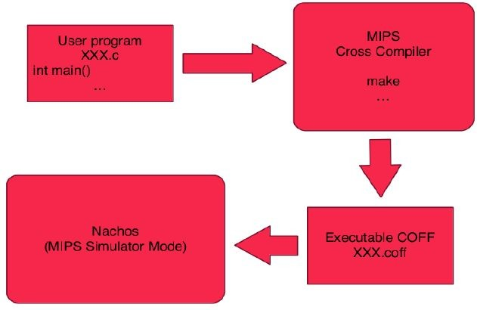
Running a user program

Slide 5
Linux: Installation of MIPS Compiler
Know your architecture using uname -a
Download the appropriate MIPS compiler
Untar it
Set the environment variables (ARCHDIR and PATH)

Slide 6
Running First User Program halt.c
In nachos/test -> make clean -> make
halt.c halt.coff
nachos -d ac -x halt.coff
(‘a’ prints debugging information)

Slide 7
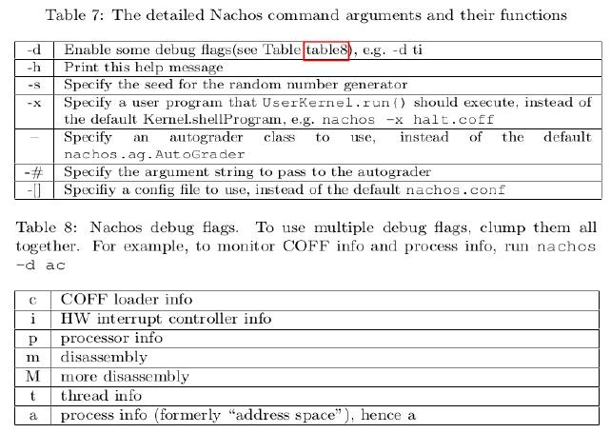
Debug flags

Slide 8
Behind the scenes
Source files (*.c) are compiled into object files (*.o) by mips-gcc
Some of the object files are linked into libnachos.a the Nachos Standard Library
start.s is preprocessed and assembled into start.o. This file contains the assembly language code to initialize a process.

Slide 9
Behind the scenes cont.
Also contains the system call “stub code” which allows system calls to be invoked. This makes use of the special MIPS instruction syscall which traps to the Nachos kernel to invoke a system call.
An object file is linked with libnachos.a to produce a Nachos compatible MIPS binary which has the extension *.coff
Can also run using nachos -x Progname.coff or add it to the Target.

Slide 10
COFF
Common Object File Format(COFF)
Specification format for executable, object code and shared library computer files used on the Unix system.
Introduced in UNIX System V, replaced a.out before being replaced by ELF - Executable and Linkable Format
So COFF is not Nachos specific - it’s an industry standard.

Slide 11
Processor - Mem Details
Main Memory is byte addressable and organized into 1KB pages
Actual Number of pages controlled by NumPhysPages
readMem and writeMem take virtual memory addresses as inputs to read and write the associated memory locations.
Address translation is handled by the translate() method that translates virtual addresses to physical addresses

Slide 12
Processor - Mem Details
Processor allows to set an exception handler to be called on any user exception.
Processor maintains 38 software accessible CPU registers including regPC and regSP for the program counter register and the stack pointer register
After loading a binary user program to the memory the PC register is initialized to point to the program entry points and SP points to top of stack.

Slide 13
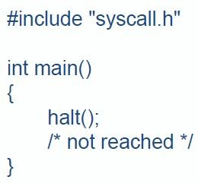
Developing User Programs
Example user program.
Seems similar to C program

Slide 14
Loading COFF Binaries
COFF binaries have a lot of information, not of much interest to us
nachos.machine.Coff abstracts off most of the details
COFF binary broken down into sections
Section - Contiguous chunk of virtual memory , all bytes of which have similar attributes - code vs data, read only vs read write, init vs uninit

Slide 15
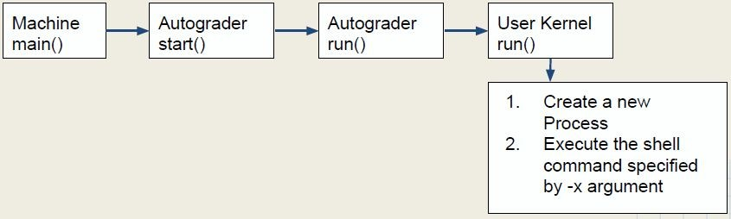
nachos.userprog
To support multi-programming UserKernel extends ThreadedKernel
Check out the difference in nachos.conf files of Project 1 and Project 2

Slide 16
User Kernel run()
public void run() {
super.run();
UserProcess process = UserProcess.newUserProcess(); String shellProgram = Machine.getShellProgramName();
Lib.assertTrue(process.execute(shellProgram, new String[] { })); KThread.currentThread().finish();
}

Slide 17
Execute program
First load the program into the process’s address space at some start address specified the section.
COFF binary specifies an initial value for the PC register and the stack pointer
Both values are stored in the UserProcess object.
Lastly, an user thread is created and stored in the ready queue

Slide 18
Execute program
public boolean execute(String name, String[] args) {
if (!load(name, args)) return false;
new UThread(this).setName(name).fork(); return true;
}

Slide 19
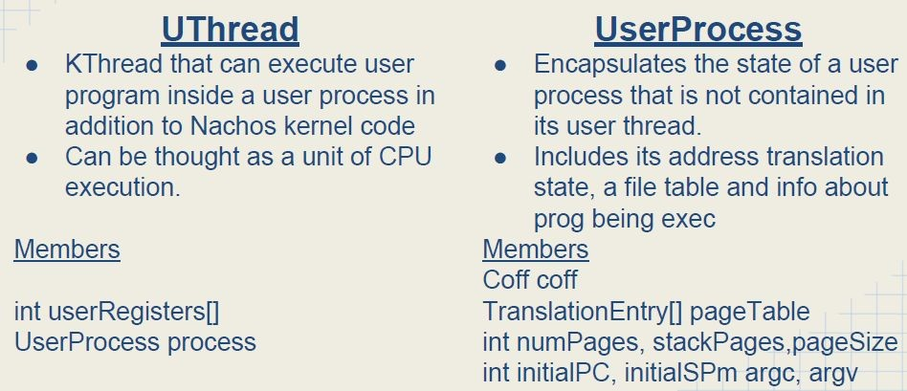
UThread and UserProcess

Slide 20
UThread
User thread initializes the PC Register and stack pointer
argc and argv is stored in the argument registers
Process’s state is restored after context switch
On Restore state, array of translation entries is specified by calling Processor. setPageTable
This pageTable specifies mapping between the virtual address to physical address.

Slide 21
UThread
Once setPageTable is called, processor will fetch the instructions from the memory location indicated by the PC register and execute the user program
If there is a context switch, registers are stored in UThread.userRegisters which are restored when the thread is scheduled again

Slide 22
System calls and exception handling
User programs make sys call by executing MIPS syscall instruction
Causes the Nachos kernel exception handler to be invoked
“cause” register set to Processor.exceptionSyscall
Kernel must register exception handler by calling Machine.processor. setExceptionHandler()

Slide 23
Default Kernel Exception Handler
Reads the value of the “cause” register
Determines the current process
Invokes handleException on current process
Passes the cause of the exception
For syscall it will be Processor.exceptionSyscall

Slide 24
Details of the system call
syscall instruction states that syscall is invoked but does not tell which syscall
This information is stored in registers as per the C convention
Register | Alias | Value
r2 | regV0 | id of the system call
r4,r5,r6,r7 | regA0, regA1, regA2, regA3 | arguments to the system call

Slide 25
Details of the system call
Return Values
r2 | regV0 | return value
registers do not store actual values, but virtual memory locations

Slide 26
First Task of Project 2
Implement file system calls
creat, open, read, write, close, unlink
Complete the implementation of the handleSysCall similar to how it handles halt
Specifications given in test/syscall.h

Slide 27
Example int open(char *name)
One argument should suffice - handleOpen(int vaddr)
To get the actual name, use UserProcess.readVirtualMemoryString(vaddr, maxFileNameLength)

Slide 28
Example int open(char *name)
To get the actual name, use UserProcess.readVirtualMemoryString(vaddr, maxFileNameLength)
Use readVirtualMemory(), readVirtualMemoryString() and writeVirtualMemory() to make use of pointer arguments to syscalls

Slide 29
Interacting with the parameters
Method Name | Parameters | Function
readVirtualMemoryString | int vaddr, byte[] data | Read a null-terminated string from this process's virtual memory
readVirtualMemory | int vaddr, byte[] data, int offset, int length | Transfer data from this process's virtual memory to the specified array.
writeVirtualMemory() | int vaddr, byte[] data, int offset, int length | Transfer data from the specified array to this process's virtual memory.

Slide 30
StubFileSystem
File system used by Nachos
Simply a stub that redirects all requests to the base operating system’s file system
Call corresponding public methods of this in the corresponding system call
For example for open you can use open public method of StubFileSystem
Study this class in detail before starting with the project

Slide 31
Success Strategy for Part 1
Install mips and have your setup up and running either on your own machine or lab machine. Try running the existing program.
Understand the flow of control for user programs right from Machine.main
Read specifications in syscall.h and the bullet points given on project page
Be familiar with the StubFilesSystem
Study how to read the virtual memory using the 3 methods for reading and writing to argument locations.

